Slide 1
Black-box testing techniques
Durga Prasad Mohapatra
Professor
Dept. of CSE
NIT Rourkela

Slide 2
Black-box Testing
Test cases are designed using only functional specification of the software:
without any knowledge of the internal structure of the software.
For this reason, black-box testing is also known as functional testing.

Slide 3
Errors detected by black box testing
Black-box testing attempts to find errors in the following categories:
To test the modules independently .
To test the functional validity of the software so that incorrect or missing functions can be recognized.
To look for interface errors. 

Slide 4
Errors detected by black box testing
To test the system behavior and check its performance .
To test the maximum load or stress on the system.
To test the software such that the user/customer accepts the system within defined acceptable limits.

Slide 5
Black-box Testing Techniques
There are many approaches to design black box test cases:
Equivalence class partitioning
Boundary value analysis
State table based testing
Decision table based testing
Cause-effect graph based testing
Orthogonal array testing
Positive-negative testing

Slide 6
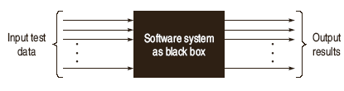
Black-box Testing

Slide 7
Equivalence Class Partitioning
Input values to a program are partitioned into equivalence classes.
Partitioning is done such that:
program behaves in similar ways to every input value belonging to an equivalence class.

Slide 8
Why define equivalence classes?
Test the code with just one representative value from each equivalence class:
as good as testing using any other values from the equivalence classes.

Slide 9
Equivalence Class Partitioning
How do you determine the equivalence classes?
examine the input data.
few general guidelines for determining the equivalence classes can be given

Slide 10
Equivalence Class Partitioning
If the input data to the program is specified by a range of values:
e.g. numbers between 1 to 5000.
one valid and two invalid equivalence classes are defined.
1
5000

Slide 11
Equivalence Class Partitioning
If input is an enumerated set of values:
e.g. {a,b,c}
one equivalence class for valid input values
another equivalence class for invalid input values should be defined.

Slide 12
Example - 1
A program reads an input value in the range of 1 and 5000:
computes the square root of the input number
SQRT

Slide 13
Example - 1 (cont.)
There are three equivalence classes:
the set of negative integers,
set of integers in the range of 1 and 5000,
integers larger than 5000.
1
5000

Slide 14
Example - 1(cont.)
The test suite must include:
representatives from each of the three equivalence classes:
a possible test suite can be: {-5,500,6000}.
5000
1

Slide 15
Example - 2
A program reads three numbers, A, B, and C, with a range [1, 50] and prints the largest number. Design test cases for this program using equivalence class testing technique.

Slide 16
Solution
1. First we partition the domain of input as valid input values and invalid values, getting the following classes:
I1 = {<A, B, C> : 1 ≤ A ≤ 50}
I2 = {<A, B, C> : 1 ≤ B ≤ 50}
I3 = {<A, B, C> : 1 ≤ C ≤ 50}
I4 = {<A, B, C> : A < 1}

Slide 17
Solution
I5 = {<A, B, C> : A > 50}
I6 = {<A, B, C> : B < 1}
I7 = {<A, B, C> : B > 50}
I8 = {<A, B, C> : C < 1}
I9 = {<A, B, C> : C > 50}

Slide 18
Solution
Now the test cases can be designed from the above derived classes, taking
one test case from each class such that the test case covers maximum valid input classes, and
separate test cases for each invalid class.

Slide 19
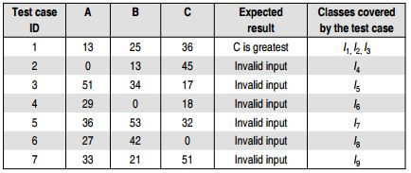
Solution
The test cases are shown below:

Slide 20
Solution
2. We can derive another set of equivalence classes based on some possibilities for three integers, A, B, and C. These are given below:
I1 = {<A, B, C> : A > B, A > C}
I2 = {<A, B, C> : B > A, B > C}
I3 = {<A, B, C> : C > A, C > B}

Slide 21
Solution
I4 = {<A, B, C> : A = B, A ≠ C}
I5 = {<A, B, C> : B = C, A ≠ B}
I6 = {<A, B, C> : A = C, C ≠ B}
I7 = {<A, B, C> : A = B = C}

Slide 22
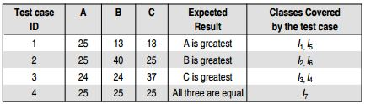
Solution

Slide 23
Example - 3
A program determines the next date in the calendar. Its input is entered in the form of with the following range:
1 ≤ mm ≤ 12
1 ≤ dd ≤ 31
1900 ≤ yyyy ≤ 2025

Slide 24
Example
Its output would be the next date or an error message ‘invalid date.’ Design test cases using equivalence class partitioning method.

Slide 25
Solution
First, we partition the domain of input in terms of valid input values and invalid values, getting the following classes:
I1 = { <m, d, y> : 1 ≤ m ≤ 12}
I2 = {<m, d, y> : 1 ≤ d ≤ 31}
I3 = {<m, d, y> : 1900 ≤ y ≤ 2025}
I4 = {<m, d, y> : m < 1}

Slide 26
Solution
I5 = {<m, d, y> : m > 12}
I6 = {<m, d, y> : d < 1}
I7 = {<m, d, y> : d > 31}
I8 = {<m, d, y> : y < 1900}
I9 = {<m, d, y> : y > 2025}

Slide 27
Solution
The test cases can be designed from the above derived classes,
taking one test case from each class such that the test case covers maximum valid input classes, and
separate test cases for each invalid class.
The test cases are shown in next slide.

Slide 28
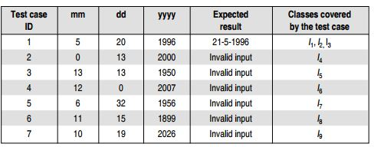
Solution

Slide 29
Example - 4
A program takes an angle as input within the range [0, 360] and determines in which quadrant the angle lies. Design test cases using equivalence class partitioning method.

Slide 30
Solution
1. First, we partition the domain of input as valid and invalid classes as follows:
I1 = {<Angle> : 0 ≤ Angle ≤ 360}
I2 = {<Angle> : Angle < 0}
I3 = {<Angle> : Angle > 360}

Slide 31
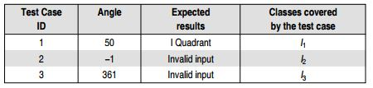
Solution
The test cases designed from these classes are shown below:

Slide 32
Solution
2. The classes can also be prepared based on the output criteria as shown below:
O1 = {<Angle>: First Quadrant, if 0 ≤ Angle ≤ 90}
O2 = {<Angle>: Second Quadrant, if 91 ≤ Angle ≤ 180}
O3 = {<Angle>: Third Quadrant, if 181 ≤ Angle ≤ 270}

Slide 33
Solution
O4 = {<Angle>: Fourth Quadrant, if 271 ≤ Angle ≤ 360}
O5 = {<Angle>: Invalid Angle};
However, O5 is not sufficient to cover all invalid conditions this way. Therefore, it must be further divided into equivalence classes as shown in next slide:

Slide 34
Solution
O51={<Angle>: Invalid Angle, if Angle > 360}
O52={<Angle>: Invalid Angle, if Angle < 0}

Slide 35
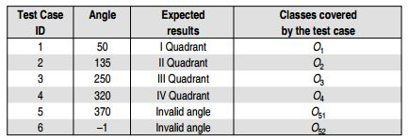
Solution
Now, the test cases can be designed from the above derived classes as shown below:

Slide 36
Summary
Discussed the errors detected by black-box test testing techniques.
Explained equivalence partitioning technique with some examples.

Slide 37
References
Rajib Mall, Fundamentals of Software Engineering, (Chapter – 10), Fifth Edition, PHI Learning Pvt. Ltd., 2018.
Naresh Chauhan, Software Testing: Principles and Practices, (Chapter – 4), Second Edition, Oxford University Press, 2016.

Slide 38
Thank You

